Slide 1

 | Department of Computer Engineering S.S.V.P.S’s B. S. Deore Polytechnic, Dhule Academic Year : 2019 – 2020 Second Shift (1100)
A seminar on Industrial Training (ITR - 22057)
Presented by |  | 1.Samarthya Deore | 2.Suprabha Gangurde
 |  | 3.Ekta Jain | 4.Dhruv Makhija
 |  | 5.Rasika Patil
Name of Industry |  | InnovationsHub Services Pvt. Ltd ,Nashik.
Training on |  | Full Stack Development (Web Development)
Name of Mentor |  | Mr. Chandrashekar Bhamare.
Date : |  | 7-6-2023

Slide 2
Content
  Abstract
  Introduction of Industry
  Industry Portfolio
  Weekly Job Summary
  Mini Project
  Practical Experiences
  Conclusion
  References

Slide 3
1.Abstract
Through the immersive courses on HTML, CSS, Bootstrap, JavaScript, and PHP at InnovationsHub Services Pvt.Ltd, Nashik. This presentation encapsulates the transformative experience of acquiring and applying vital web development skills in crafting an innovative project.
Throughout the courses, we delved into front-end and back-end web development fundamentals, gaining comprehensive knowledge in building dynamic web pages, crafting appealing layouts, and implementing interactive functionalities.
The "Shoe Website" mini-project served as the pinnacle of this learning journey, where we put our newfound skills to the test. The project aimed to design and develop an e-commerce platform. Leveraging the power of HTML, CSS, Bootstrap, JavaScript, and PHP, we successfully crafted an immersive online shopping experience, offering navigation, visually captivating designs, and robust back-end functionalities.
In this presentation, we will explore the key highlights of the courses and the concepts learned during the course. Additionally, we will showcase the features of the "Shoe Website" mini-project, illustrating how the fusion of HTML, CSS, Bootstrap, JavaScript, and PHP develops a website.

Slide 4
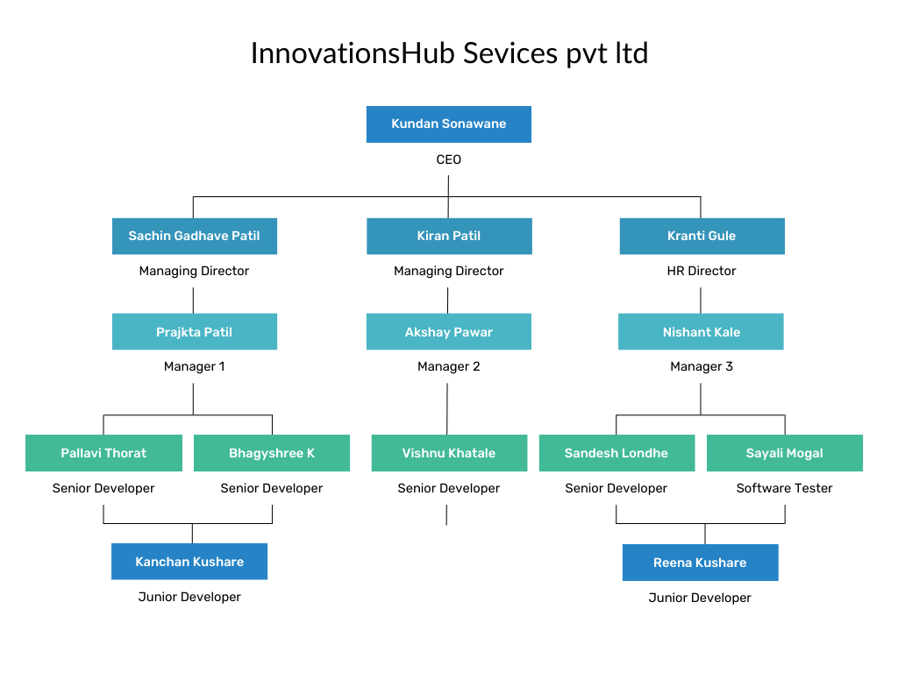
2.Introduction to Industry

Slide 5
3.Industry Portfolio
COMPANY/ INDUSTRY PROFILE:-
Name of the Company: InnovationsHub Services Pvt Ltd.
Location: Reg. Office: 49, Vakratund Bungalow, Amrutdham, Nashik-422003, India
Establishment: 2018
Email & Web Address: www.innovationshub.in
Name and Designation of Owners / Contact Person: Sachin Patil(Director)
Contact Number of Owners / Contact Person: 9021721618
2.2 TYPE OF PRODUCTS AND SERVICES:
Websites, Mobile Application, ERP, E-commerce, Online Marketing Animation, Commercial Billing Software
2.3 HISTORY:-
Winner of the Smart India Hackathon 2022 (project-sponsored), organized by the
Ministry of Education (MoE).
InnovationsHub creates technology solutions for retailers and commercial businesses to improve customer profitability.
Develop POCs to test out new technologies and solutions.
Industry Expertise: Healthcare, API Banking, Retail, Research and development.
Technology Highlights:
  Cloud Platforms (SaaS | Cloud SQL | Cloud Storage)
  Data Modelling, NoSQL, and Relational DBs
  Web Services, Portals, and Dashboards.
  Mobile Apps and Experiences (Android | Cloud)
  Digital Marketing(SEO | Social Media)
  Training and Internship(Web | Android | Java | Python | AWS | Automation)

Slide 6

Introduction to JavaScript
What is JavaScript?
JavaScript is a scripting language for creating dynamic web page content. JavaScript was invented by Brendan Eich in 1995, and became an ECMA ( European Computer Manufacturer's Association) standard in 1997. ECMA-262 is the official name of the standard. ECMAScript is the official name of the language. It creates elements for improving site visitors' interaction with web pages, such as dropdown menus, animated graphics, and dynamic background colors.
What is the use of JavaScript?
JavaScript provides users to interact with web pages as per the below examples as per the requirements. Show/hide more data or user information using with the click of a button. Change the color of a button after hovering the mouse hovers over it. Slide by a carousel of images on the home webpage.

Slide 7
Why Use JavaScript in Web Development?
Improved Website Interactivity
JavaScript provides efficient website interactivity, including dropdown menus, animated widgets, and form validation, among others.
Enhanced User Experience
JavaScript enables a dynamic and responsive user experience, making it a go-to language for web developers.
Compatible with Multiple Devices
JavaScript works across various browsers and devices, including desktops, smartphones, and tablets, making it a language that appeals to a broad user base.

Slide 8
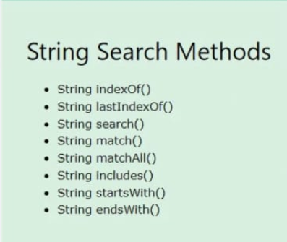
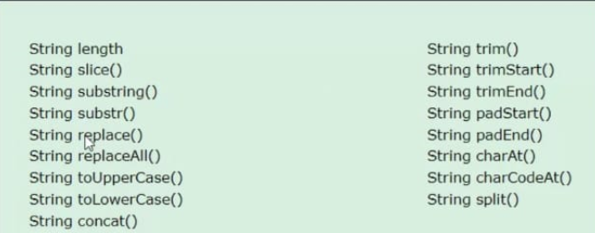
String Methods in JavaScript
Operator | Description
+ | Addition
- | Subtraction
* | Multiplication
** | Exponentiation (ES2016)
/ | Division
% | Modulus (Division Remainder)
++ | Increment
-- | Decrement
Operators
In
JavaScript

Slide 9
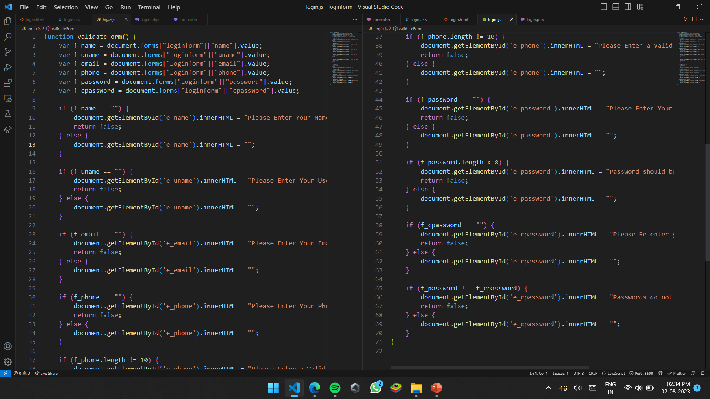
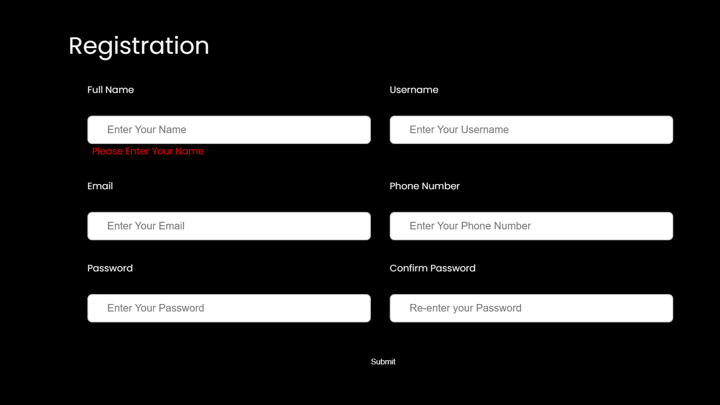
Example of Form Validation using JavaScript

Slide 10
6.Practical Experiences
We learned how to work in a team on a project .
Learned different tools and software’s which are used by company to develop applications.
Learned how to design project flow from requirements.
We learned how to develop static websites as per requirements.
We went through different products developed by company and understood features of that product
We studied all services provided by InnovationsHub Services Pvt.Ltd.

Slide 11
7.Conclusion
It was a good & and memorable experience of the 6 weeks in the company. During the training I got technical & practical knowledge, in fact, it was an opportunity to me to observe, how the various departments co-ordinate in between them & how they were trying to plan, organize, control & manage the work properly to achieve the organizational goals. We learned about various concepts of HTML, CSS, Bootstrap, JavaScript and PHP, along with developing a project based on those concepts.

Slide 12
8.References
WEBSITE:
  W3Schools.com
  Bootstrapmade.com
INDUSTRY:
InnovationsHub Service Pvt. Ltd, Nashik

